Slide 1
Bill of Rights
The First 10 Amendments of the United States Constitution!

Slide 2
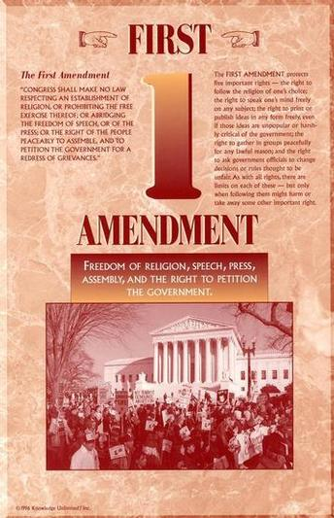
Bill of Rights
Amendment I - Freedom of Religion, Press, Speech, Assembly, & Petition
Congress shall make no law respecting an establishment of religion, or prohibiting the free exercise thereof; or abridging the freedom of speech, or of the press; or the right of the people peaceably to assemble, and to petition the government for a redress of grievances.
Guarantees freedom of religion, speech, assembly, and press, and the right of people to petition the government.

Slide 3
Bill of Rights
Amendment I - Freedom of Religion, Press, Speech, Assembly, & Petition
1. Slander (false speech intended to damage a person’s reputation) and libel (similar to slander except it applies to written or published statements) are both illegal
2. You must be responsible. For example, you cannot endanger the nation’s safety by giving away military secrets or call for the violent overthrow of the gov’t.
3. Don’t cry “Fire” in a crowded theatre

Slide 4
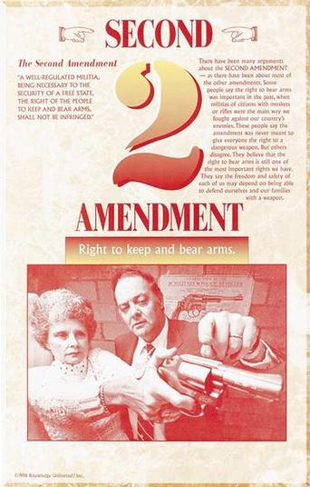
Amendment II - Bearing Arms – National Guard for states, regulate private possession of firearms
A well regulated militia, being necessary to the security of a free state, the right of the people to keep and bear arms, shall not be infringed.
Originally intended to prevent the national government from taking away weapons.

Slide 5
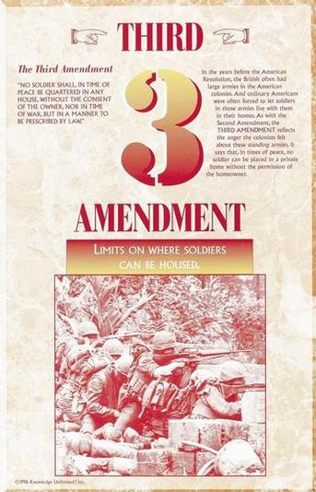
Amendment III – Quartering (Housing) troops – not really relevant today.
No soldier shall, in time of peace be quartered in any house, without the consent of the owner, nor in time of war, but in a manner to be prescribed by law.
Prohibits government from forcing people to provide shelter for soldiers.

Slide 6
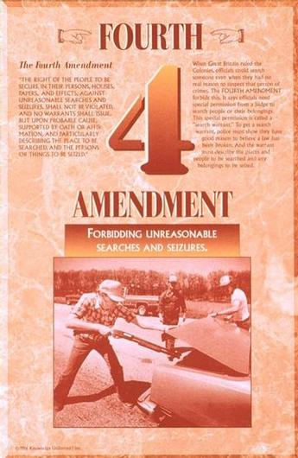
Amendment IV – Searches and Seizures
The right of the people to be secure in their persons, houses, papers, and effects, against unreasonable searches and seizures, shall not be violated, and no warrants shall issue, but upon probable cause, supported by oath or affirmation, and particularly describing the place to be searched, and the persons or things to be seized.
A search or an arrest also requires a search warrant or an arrest warrant

Slide 7
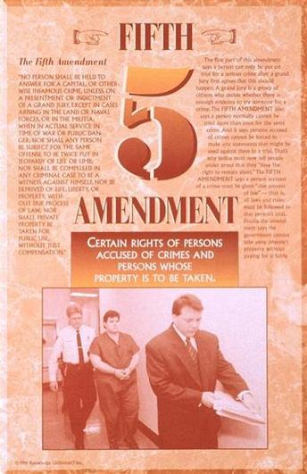
Amendment V – Criminal Proceedings; Due Process, Eminent Domain
Double Jeopardy, Can’t be forced to incriminate yourself, if charged with a federal crime, one must be charged by a grand jury.
No person shall be held to answer for a capital, or otherwise infamous crime, unless on a presentment or indictment of a grand jury, except in cases arising in the land or naval forces, or in the militia, when in actual service in time of war or public danger; nor shall any person be subject for the same offense to be twice put in jeopardy of life or limb; nor shall be compelled in any criminal case to be a witness against himself, nor be deprived of life, liberty, or property, without due process of law; nor shall private property be taken for public use, without just compensation.

Slide 8
Amendment V – Criminal Proceedings; Due Process, Eminent Domain
Double Jeopardy, Can’t be forced to incriminate yourself, if charged with a federal crime, one must be charged by a grand jury.
No one can be tried for a serious crime unless a grand jury has decided there is enough evidence to justify a trial
Cannot be tried for the same crime twice
Cannot be forced to testify against himself or herself

Slide 9
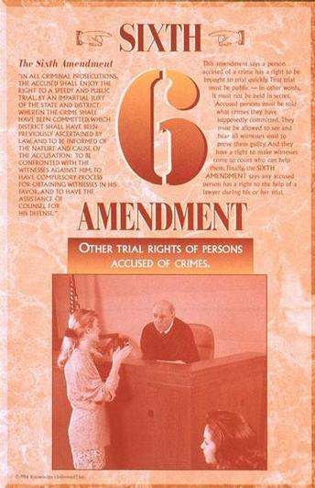
Amendment VI - Criminal Proceedings
In all criminal prosecutions, the accused shall enjoy the right to a speedy and public trial, by an impartial jury of the state and district wherein the crime shall have been committed, which district shall have been previously ascertained by law, and to be informed of the nature and cause of the accusation; to be confronted with the witnesses against him; to have compulsory process for obtaining witnesses in his favor, and to have the assistance of counsel for his defense.

Slide 10
Amendment VI - Criminal Proceedings
Guarantees the right to a speedy and public trial by an impartial jury.
Must be given assistance of councel for defense.

Slide 11
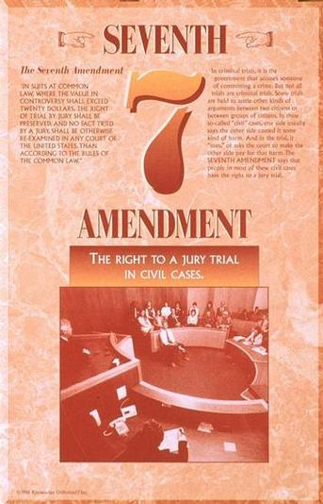
Amendment VII – Civil Trials over $20 right to trial by jury
Anything Non-Criminal, sue for a monetary gain
In suits at common law – Just Laws on the Books, where the value in controversy shall exceed twenty dollars, the right of trial by jury shall be preserved, and no fact tried by a jury, shall be otherwise reexamined in any court of the United States, than according to the rules of the common law.
Note: trial by jury may be waived if both parties agree to bench trial – judge

Slide 12
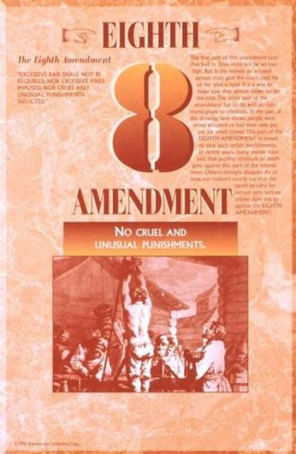
Amendment VIII – No Cruel and Unusual Punishment
(Punishment for crimes - must match the crime)
Excessive bail shall not be required, nor excessive fines imposed, nor cruel and unusual punishments inflicted.

Slide 13
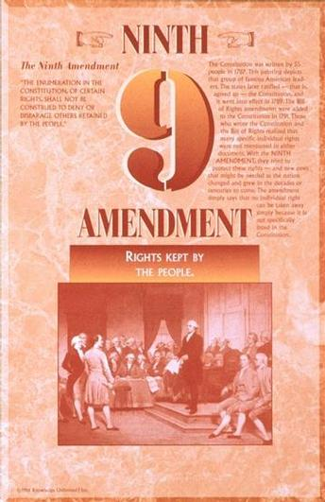
Amendment IX – Unenumerated Rights –
There are other rights in addition to the Constitutional rights
The enumeration in the Constitution, of certain rights, shall not be construed to deny or disparage others retained by the people.

Slide 14
Amendment IX – Unenumerated Rights –
Protects all basic or natural rights not specifically noted in the Constitution

Slide 15
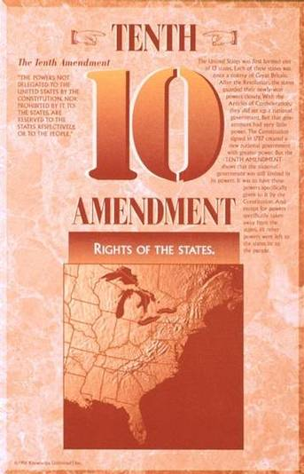
Amendment X – Powers Reserved to the States
Whatever is not granted to the Federal Government is granted to the states
The powers not delegated to the United States by the Constitution, nor prohibited by it to the states, are reserved to the states respectively, or to the people.

Slide 16
Example
1st Amendment: Freedoms of speech, religion, press, assembly, petition
Human rights- worship god of choice, make complaints in order to make change
Laws that limit those rights- no human sacrifices/abuse in the name of religion, cannot yell “Fire” in a movie theater, cannot print false statements about someone/business

